Slide 1

Explore Zomato restaurants dataset in the city of Kochi

Slide 2
Introduction
Kochi is a major city of India. It is a part of Ernakulam district. The city itself has a population of more than a million. Called the "Queen of the Arabian Sea", Kochi was an important spice trading centre on the west coast of India from the 14th century onward, and maintained a trade network with Arab merchants from the pre-Islamic era. Occupied by the Portuguese in 1503, Kochi was the first of the European colonies in colonial India.
The official language of Malayalam. However, English is also spoken as a formal language within businesses and government agencies. Over last decades it is continuously grow because of the city’s important role in government and commercial business.So as part of this project , we will list and visualize all major parts of Kochi and the restaurants.

Slide 3
Objectives
Questions that can be asked using the above mentioned datasets
Which is best location in Kochi City for Chinese Cuisine ?
Which areas have large number of Chinese Restaurant Market ?
Which all areas have less number of restaurant ?
Which is the best place to stay if I prefer Chinese Cuisine ?
What places are have best restaurant in Kochi?

Slide 4
Data
For this project we need the following data :
Kochi Restaurants data that contains list Locality, Restaurant name, Rating along with their latitude and longitude.
Data source : Zomato kaggel dataset
Description : This data set contains the required information. And we will use this data set to explore various locality of Kochi.
Nearby places in each locality of Kochi city.
Data source : Fousquare API
Description : By using this api we will get all the venues in each neighborhood.

Slide 5
Approach
Collect the new delhi city data from Zomato kaggel dataset
Using FourSquare API we will find all venues for each neighborhood.
Filter out all venues that are nearby by locality.
Using aggregative rating for each resturant to find the best places.
Visualize the Ranking of neighborhoods using folium library(python)

Slide 6
Results

Slide 7
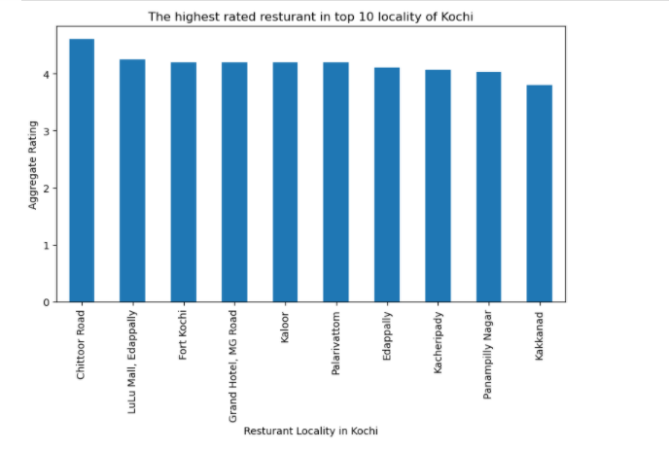
Which places are have best restaurants in Kochi?

Slide 8
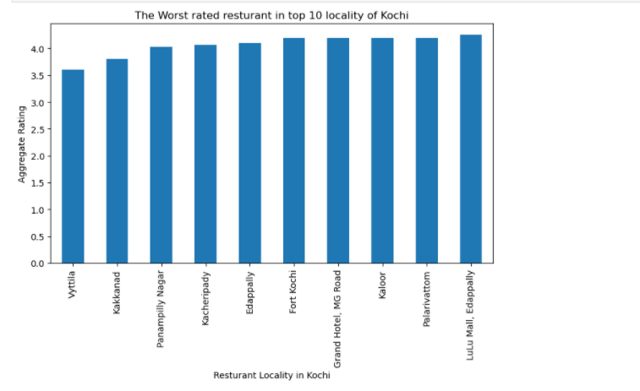
Which places have worst restaurants in Kochi?

Slide 9
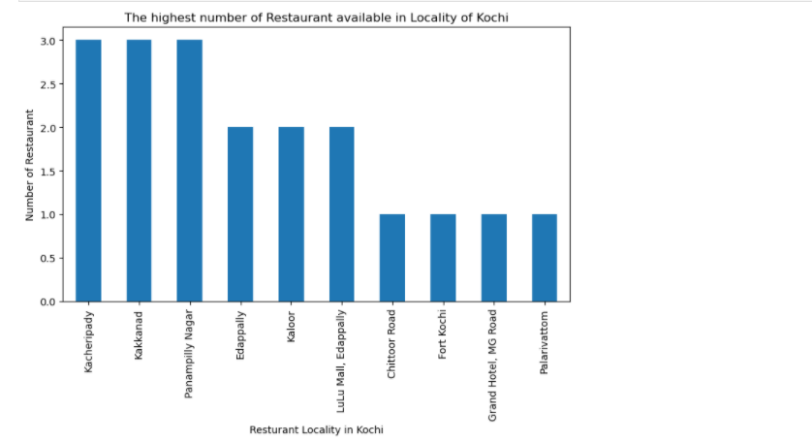
Which places have highest number of restaurants in Kochi?

Slide 10
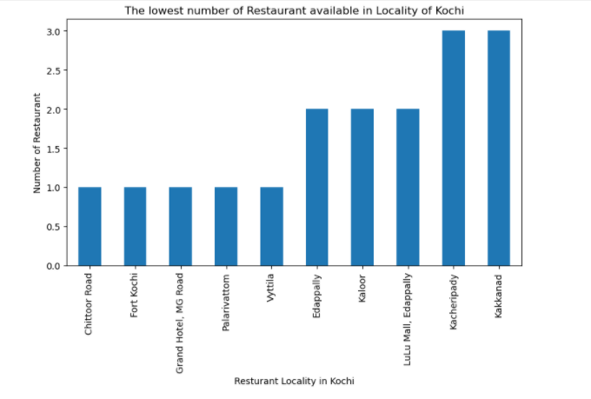
Which places have lowest number of restaurants in Kochi?

Slide 11
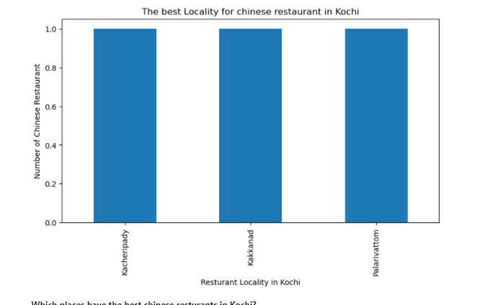
Which localities have best Chinese restaurants in Kochi?

Slide 12
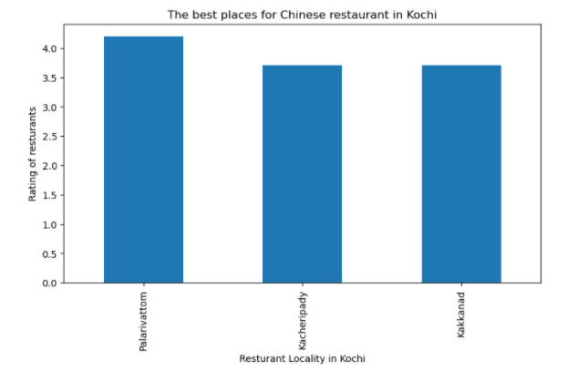
The best places for Chinese restaurants in Kochi

Slide 13
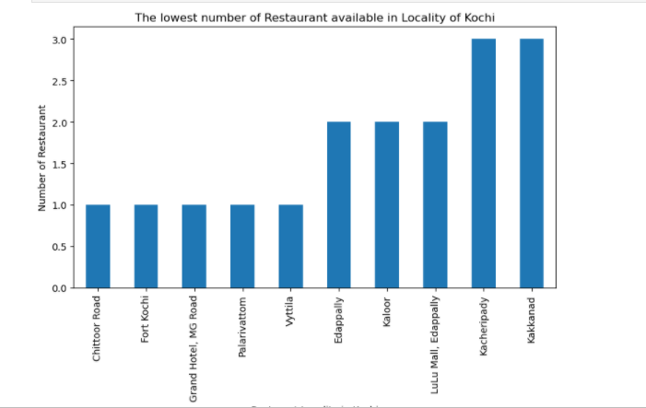
Which localities have lowest number of restaurants in Kochi?

Slide 14
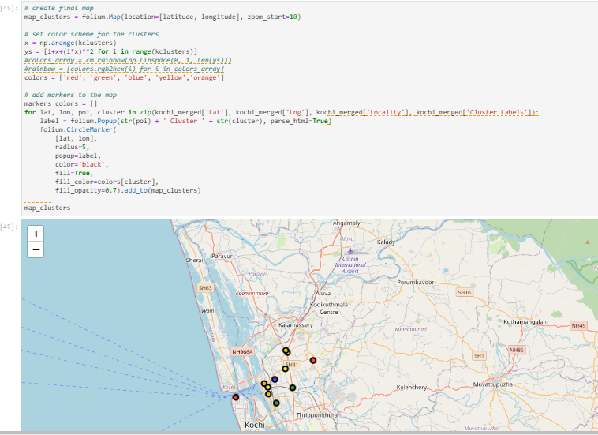
Creating final map of the clusters created around Kochi using Folium

Slide 15
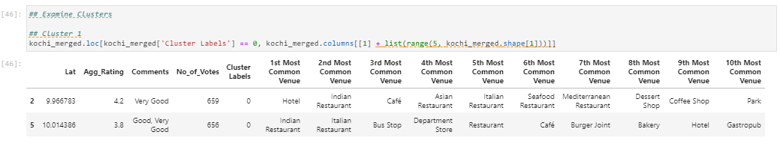
Cluster 1:
The Indian restaurants are most recommended venues nearby the locations.

Slide 16
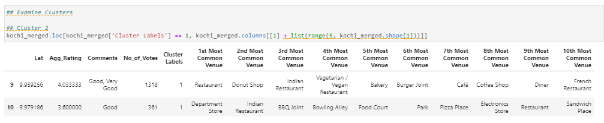
Cluster 2:
It is recommended for the Hotel venues areas:

Slide 17
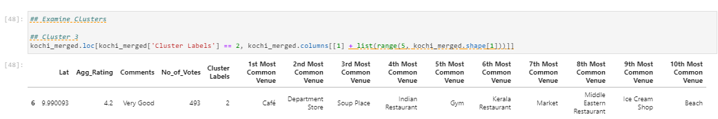
Cluster 3:
Cluster 3 recommends café’s

Slide 18
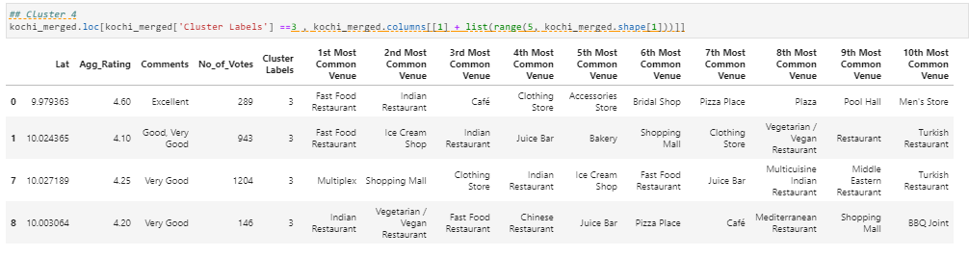
Cluster 4:
Cluster 4 most recommended for cafes and fast food

Slide 19
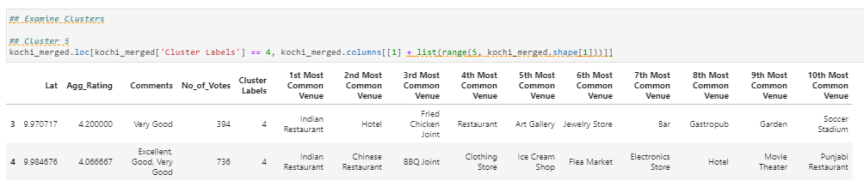
Cluster 5:
Fast food, cafes are the most recommended venues in Cluster 5

Slide 20
Conclusion
Palarivottom, Kacheripady and Kakkanad are some of the best neighborhoods for Chinese cuisine.
Palarivottom and Kacheripady have the best Chinese Restaurant.
Kacheripady Kakkanad and Panampilly Nagar are the best places for edible person.
Chittoor Road, Lulu Mall,Edapally and Fort Kochi have best rated restaurants in New Delhi.

